Slide 1

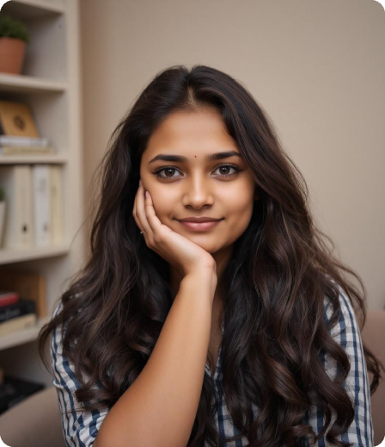








Lana - Accountant
Anushka, is a marketing professional who seeks balance and growth in all areas of her life. She uses apps for mindfulness, wellness, and productivity, but feels her current tools fall short in terms of creativity and customization. Sarah enjoys reflecting on her day through journaling, but she craves more visually engaging and personalized ways to track her progress.
Bio
Demography
Technology
Age: 22
Gender: Female
Education: Graduated
Profession: Marketing Professional
Location: gandhinagar
motivation
Self Care
Creativity
Core needs
Frustrations
Visually engaging, customizable habit tracker.
Journaling and reflections for wellness and mindfulness.
Creative rewards like badges and avatars.
Static, non-customizable apps.
Lack of prompts or inspiration for self-reflection and habit suggestions.
Quote
Personality trait
“I want a habit tracker that’s as creative and organized as I am; it should inspire me to grow every day.”
Reflective
Creative
Organized

Slide 2
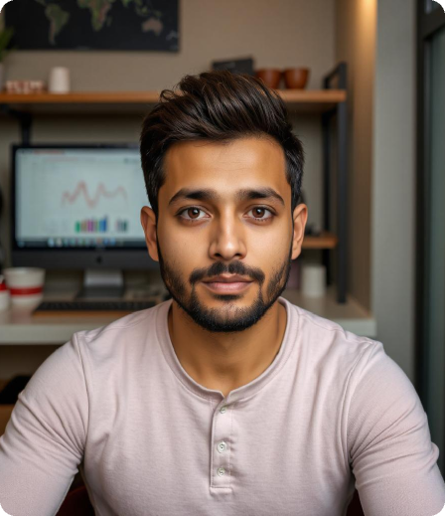


Lana - Accountant
Bio
Arjun, is a software developer who thrives on progress but struggles with staying motivated long-term. He’s always looking for tools to help him achieve his goals and enjoys friendly competition that keeps him engaged. He values instant feedback and rewards but often finds tracking his habits to be a chore.
Demography
Technology
Age: 25
Gender: Male
Education: Graduated
Profession: Software Developer
Location: Vadodara
Productivity apps
Self Care
easy to use
Core needs
Frustrations
Engaging, fun ways to track habits.
Instant feedback and rewards to keep him motivated.
Social features like leaderboards to fuel his competitive nature.
Habit tracking that feels like a burden, not rewarding.
Lack of progress indicators or acknowledgment when goals are achieved.
Quote
Personality trait
"I want to track my habits in a way that feels rewarding and fun, not like a chore."
competitive
ambitious
Reward-driven

